Slide 1
Catechesis &
Youth Ministry
January 24, 2017
Women Youth Apostles
by Michael Filamor

Slide 2
What is Catechesis?
Catechesis is the Church’s practice of handing on the faith.
The purpose of catechesis is Understanding and Change… (CT 20)
…and communion with Christ (Trinity) (CT 5)

Slide 3
What is Evangelization?
Evangelization is "the process by which the Church... proclaims and spreads the Gospel.” (GDC 48)
The purpose of evangelization is others’ interior change. (EN 18)
“There is no true evangelization if…Jesus [is] not proclaimed." (EN 22, GDC 50)

Slide 4
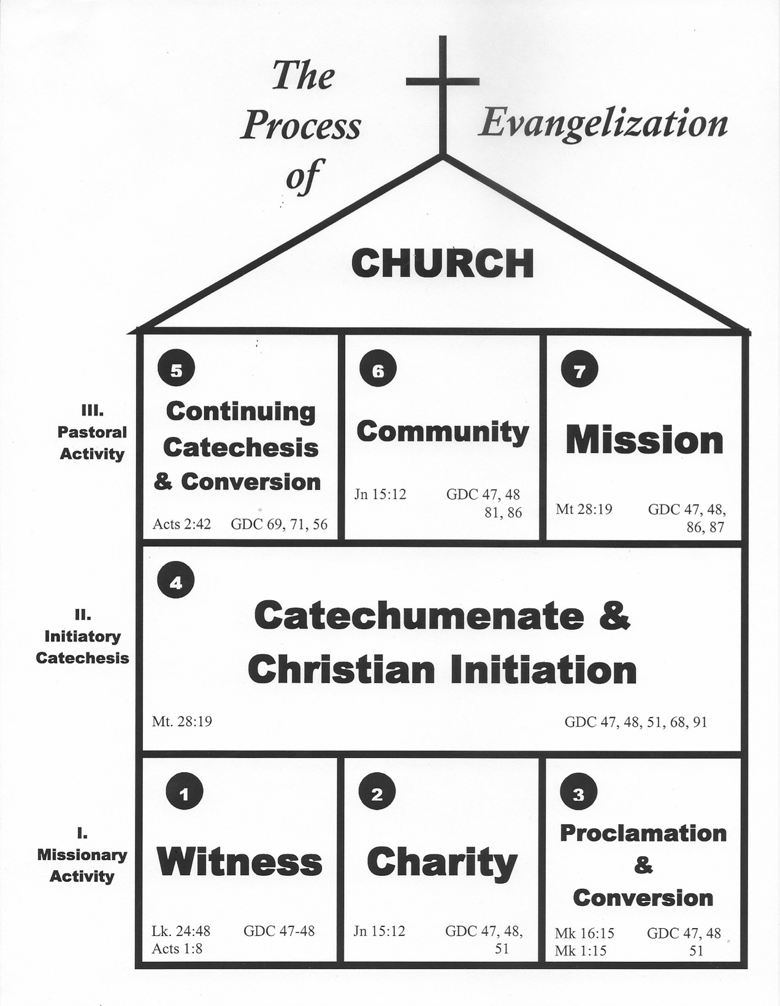

Slide 5
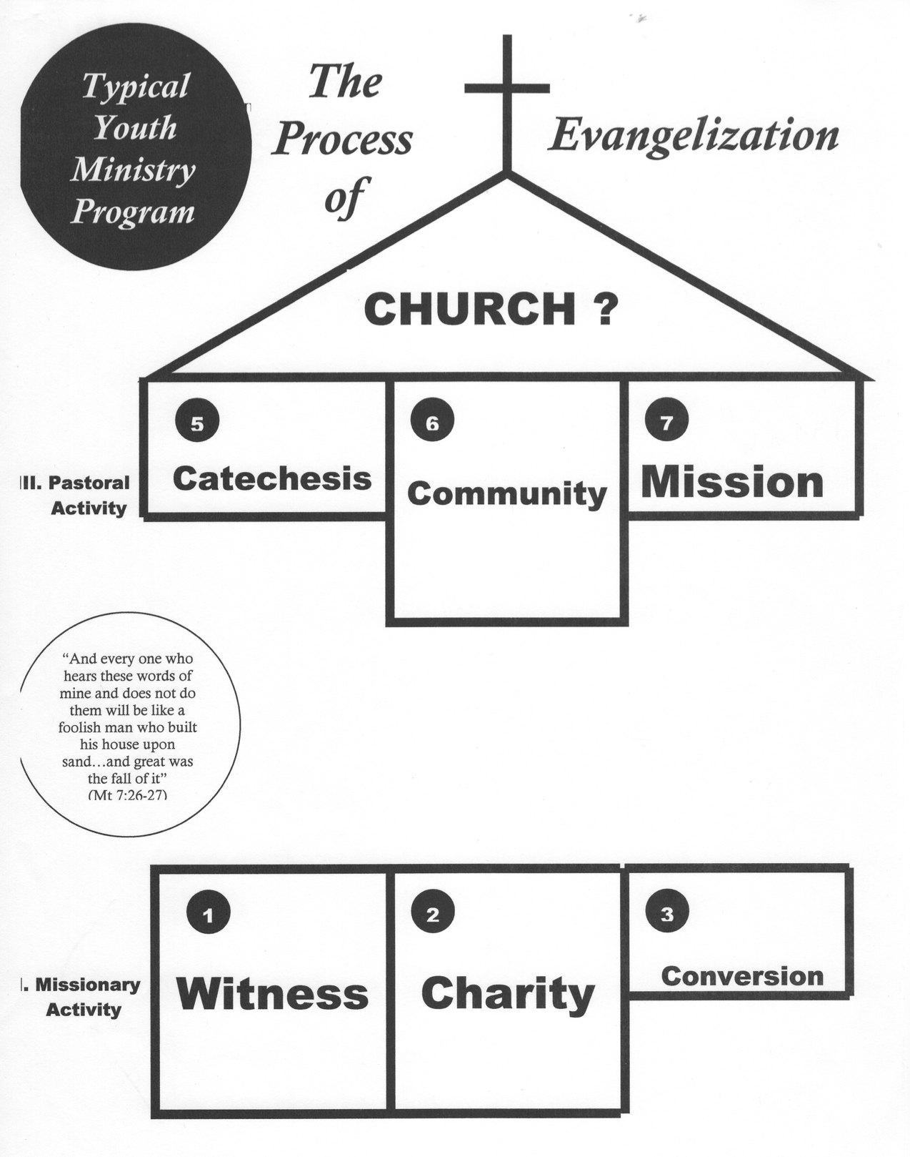

Slide 6
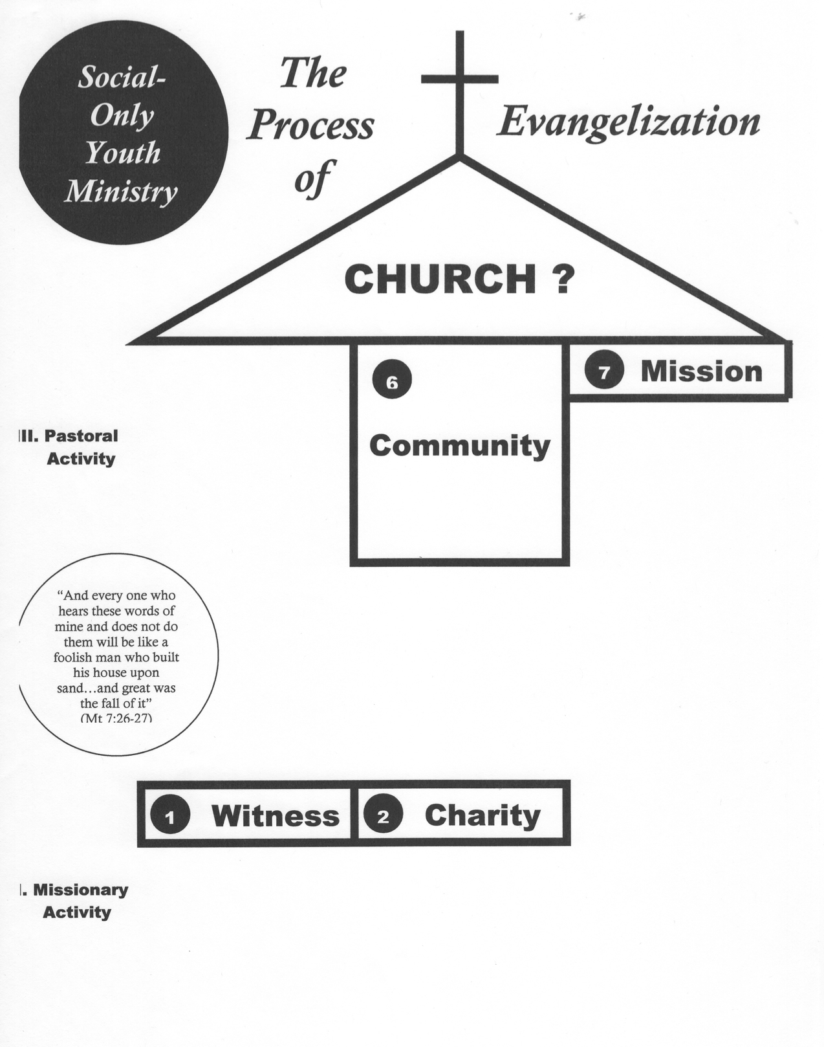

Slide 7
TEACHING DOCTRINE:
The Five Components
I. Premise
II. Essentials
III. Common Misunderstandings
IV. Scriptural Basis
V. Related Doctrines

Slide 8
I. Teach the Premise
The premise is the underlying truth upon which the doctrine is based.
WHAT? and SO WHAT?: What is the foundation? and What is the purpose and why is this important?
Not always the definition. Teach as certitudes.
Keep it short and sweet. Use the Catechism.

Slide 9
I. Teach the Premise: FAITH
The premise is the underlying truth upon which the doctrine is based.
"We believe because of the authority of God who reveals. He cannot deceive nor be deceived" (CCC 156).

Slide 10
II. Teach the Essentials
Essentials are aspects of the doctrine which cannot be left to chance that they will get them on their own.
The basics are best. They are what God wanted to say, what He wanted us to be sure about.
Make this compelling with your witness and how culture has distorted the essentials.

Slide 11
II. Teach the Essentials: FAITH
Essentials are aspects of the doctrine which cannot be left to chance that they will get them on their own.
Faith
1. is certain.
2. is necessary for salvation.
3. seeks understanding.
4. a gift.
5. can be lost and increased. (CCC 153-165)

Slide 12
III. Teach the Common Misunderstandings
Address and clear away misconceptions that resulted from insufficient/ineffective catechesis and the culture.
Consider your audience, not just your own misunderstandings.
Define words and concepts so that they can fully understand the premise.

Slide 13
III. Teach the Common Misunderstandings: FAITH
Address and clear away misconceptions that resulted from insufficient/ineffective catechesis and the culture.
Misconception: Faith is a blind leap.
We believe not just because of natural reason but by God’s authority; He willed these external proofs. (CCC 156)

Slide 14
IV. Teach the Scriptural Basis
ALL Catholic doctrine is grounded in Scripture.
All doctrines are not necessarily explicit in scripture but are implicit in the text. (e.g. Infant Baptism)
Let Scripture undergird all your teachings. However, let the scriptures have the first say - Don’t just use them to back you up.

Slide 15
IV. Teach the Scriptural Basis: FAITH
ALL Catholic doctrine is grounded in Scripture.
"Now faith is the assurance of things hoped for, the conviction of things not seen." (Hebrews 11:1)

Slide 16
V. Teach Related Doctrines
Teach the harmony of faith and the interconnectivity of God’s revelation.
The doctrines of the Faith form a certain organic unity. They are not independent.
Doctrines build upon each other – No such thing as Cafeteria Catholicism!
See The Hierarchy of Truths. (CCC 90)

Slide 17
V. Teach Related Doctrines: FAITH
Teach the harmony of faith and the interconnectivity of God’s revelation.
Jesus is the perfecter of our Faith.
By Prayer, we can increase in Faith.
Mary is the perfect role model for the life of Faith.
The Church hands on the Faith.
Faith is necessary for Salvation.

Slide 18
Now it’s your turn!

Slide 19
I. Teach the Premise: SCRIPTURE
The premise is the underlying truth upon which the doctrine is based.
"God has chosen to speak to us in human words. He is the author of these human words" (CCC 105).

Slide 20
II. Teach the Essentials: SCRIPTURE
Essentials are aspects of the doctrine which cannot be left to chance that they will get them on their own.
1. The human authors are true authors, so Scripture has a very human element to it, though without error.
2. The Magisterium is the authentic interpreter of Scripture.
3. Christ is the center of all of Scripture
(CCC 101-141)

Slide 21
III. Teach the Common Misunderstandings: SCRIPTURE
Address and clear away misconceptions that resulted from insufficient/ineffective catechesis and the culture.
Misconception: Scripture is the only source of God's revelation to us..
Apostolic Tradition is a co-equal channel by which God’s Divine Revelation comes to us. (CCC 74-83)

Slide 22
IV. Teach the Scriptural Basis: FAITH
ALL Catholic doctrine is grounded in Scripture.
"All Scripture is inspired by God and is useful for teaching...." (2 Timothy 3:16)

Slide 23
V. Teach Related Doctrines: SCRIPTURE
Teach the harmony of faith and the interconnectivity of God’s revelation.
Scripture together with Tradition makes up the single sacred Deposit of Faith.
Reading Scripture can give increase to one's Faith.
The Church determined the canon of Scripture.
The Trinity is the principal author of Scripture.
Scripture was written for the sake of our Salvation.

